Slide 1

Brief Announcement: Efficient Distributed Algorithms for Convolutional Neural Networks
Rui Li, Yufan Xu, Aravind Sukumaran-Rajam, Atanas Rountev, P. Sadayappan
University of Utah, Washington state university, ohio state university

Slide 2
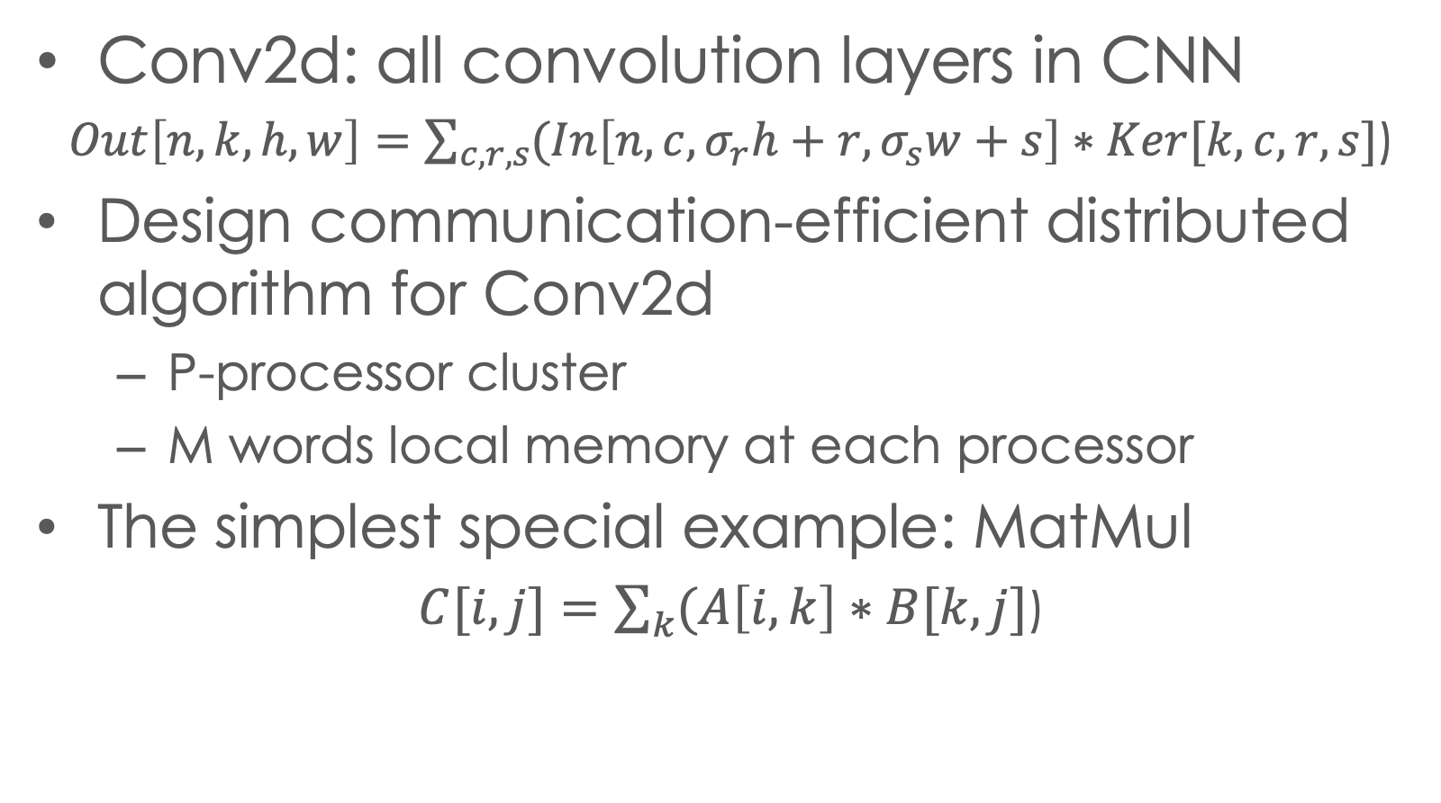
Introduction
Conv2d: all convolution layers in CNN
$Out\left[n,k,h,w\right]=\sum_{c,r,s}{(In\left[n,c,σ_{r}h+r,σ_{s}w+s\right]∗Ker[k,c,r,s}]$)
Design communication-efficient distributed algorithm for Conv2d
P-processor cluster
M words local memory at each processor
The simplest special example: MatMul
$C[i,j]=\sum_{k}{(A\left[i,k\right]∗B[k,j}]$)
Notes:
The goal is..
conv2d is a computaion with a complicated expression
we will use matmul as a example to demo paper flow

Slide 3
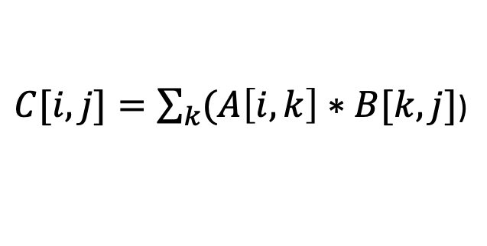
Overview
2-level tiling view of parallel algorithm on global memory
Define N, W, T
Tile size optimization problem construction under global memory assumption
Find W, T to reduce communication
Design distributed memory algorithm from the efficient global-memory solution
P0
P1
P2
P3
Problem range N
$C[i,j]=\sum_{k}{(A\left[i,k\right]∗B[k,j}]$)
C Tile
B Tile
A Tile
Local
tile T
P0 work
space W
Notes:
The overall apporoach can be summerized
at the beginning we'll construct
One the right we are showing the schema
The inner... The outer..
We'll then build ... under ..., s.t
And at the last step we'll use ... to

Slide 4
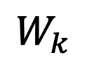

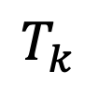
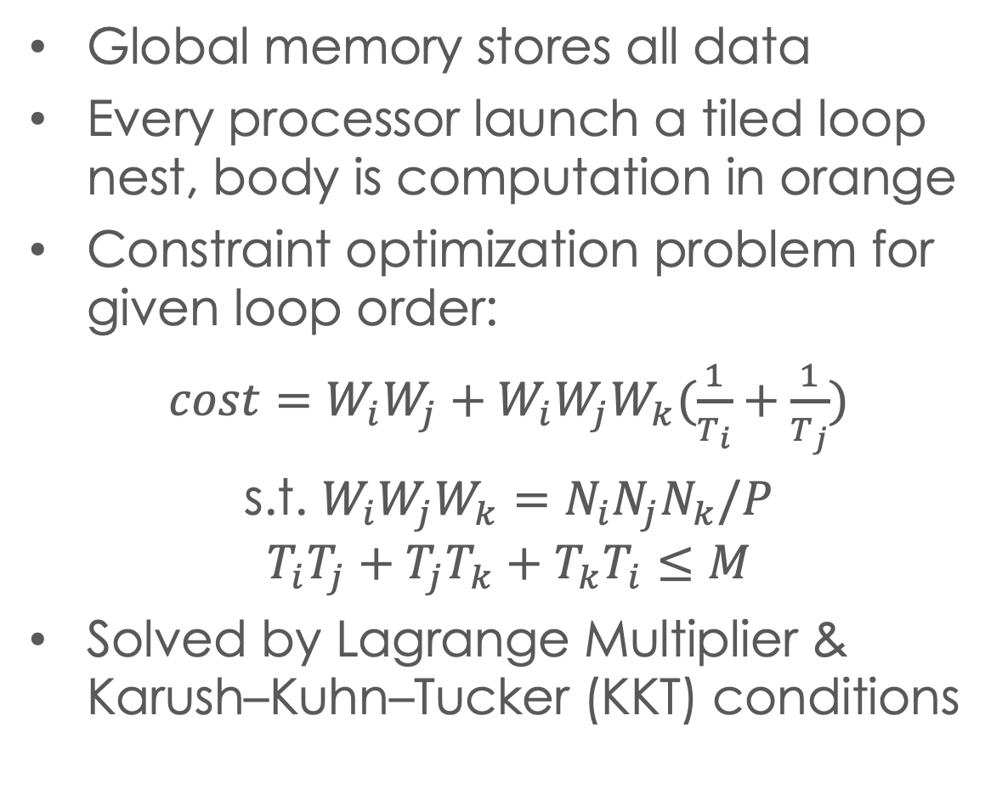
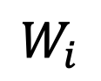

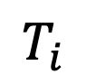
Systematic algorithm construction
Global memory stores all data
Every processor launch a tiled loop nest, body is computation in orange
Constraint optimization problem for given loop order:
$cost=W_{i}W_{j}+W_{i}W_{j}W_{k}(\frac{1}{T_{i}}+\frac{1}{T_{j}})$
s.t. $W_{i}W_{j}W_{k}=N_{i}N_{j}N_{k}/P$
$$T_{i}T_{j}+T_{j}T_{k}+T_{k}T_{i}≤M$$
Solved by Lagrange Multiplier & Karush–Kuhn–Tucker (KKT) conditions
$$T_{k}$$
Local
tile T
$$T_{i}$$
$$W_{i}$$
$$T_{j}$$
$$W_{k}$$
$$W_{j}$$
for tile_i..
for tile_j..
for tile_k..
do local tile T
Notes:
w'll then intro how to constr tile-size opt prob
Under the global memory assump, each proc will execute.... to iterate over the local work space W
The body of the tiled loop nest is T
with a fixed loop permutation, we can derive the expression of the data volume accessed from global memory.

Slide 5
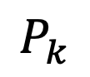
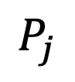
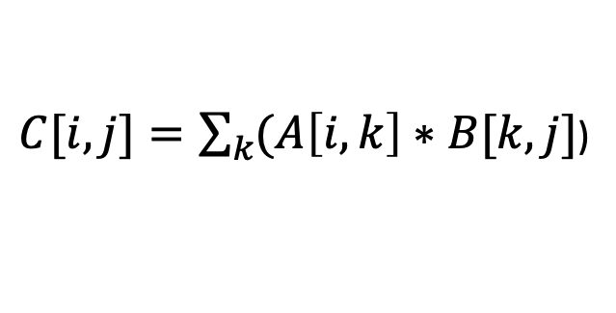
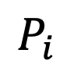
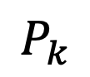
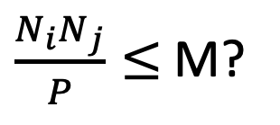
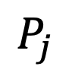
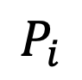
Global solution overview
$\frac{N_{i}N_{j}}{P}≤$ M?
$C[i,j]=\sum_{k}{(A\left[i,k\right]∗B[k,j}]$)
Yes, 2.5D/3D
Pk>1
Local C not tiled
No, 2D
Pk=1
cost
2D
C Tile
C
$$P_{i}$$
2.5D
3D
$$P_{i}$$
$$P_{k}$$
$$P_{k}$$
M
$$P_{j}$$
$$P_{j}$$
Notes:
the structure of glb mem sol can be expressed by the figure.
When we don't have enough local mem, s.t the summation of all local mem is less or equal to tensor C, the sol we derived will not spread proc along k dim. This is equivalent to 2D
Otherwise ... the sol we direived will spread proc along all dim, and not tile the local C footprint. this is equivalent to 2.5D and 3D. And inside this branch, if the local memory is larger than some point, we will always reach 3D solution, otherwise it will stay with the 2.5d sol.
Till here we demo, we 'll then show how to construct distributed mem algo from here

Slide 6
Construct distributed memory algorithm
Global memory
Distributed memory
C0
B4
B5
C2
B4
B5
Same C
C
A4
A6
A5
A7
replicated
Same B
C0
B0
B1
C2
B0
B1
C
B0
broadcast
A0
A2
A0
B1
A1
A3
Nj
B2
B3
B2
B3
Nj
C1
C3
Same A
broadcast
A1
A0
A2
Nk
Nk
A1
A3
Ni
Ni
Notes:
each proc is executing a local tiled loop. the tile footprint of the first iter is shown in the figure. at the next iteration it will keep reuse Ctile and load new A,B tile from global mem
we can observe the proc along the k dim is using the same footprint of C, j-A, i-B.
based on the schedule we can create a dist alg as follows. we will replicate the FP of C along k, and we distribute A footprint along j, B along i. In this example, all proc at left side holds first half of B, and all pro at right side holds second half of B. So when the tiled loop exe on first half itertions, all proc on left will bcast data, ..
by doing that we can utilize tile size of glb mem sol to form a dist mem alg

Slide 7
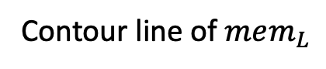
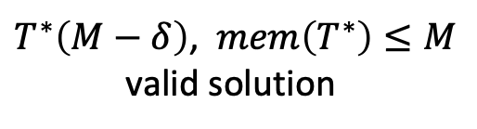
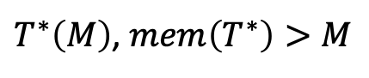
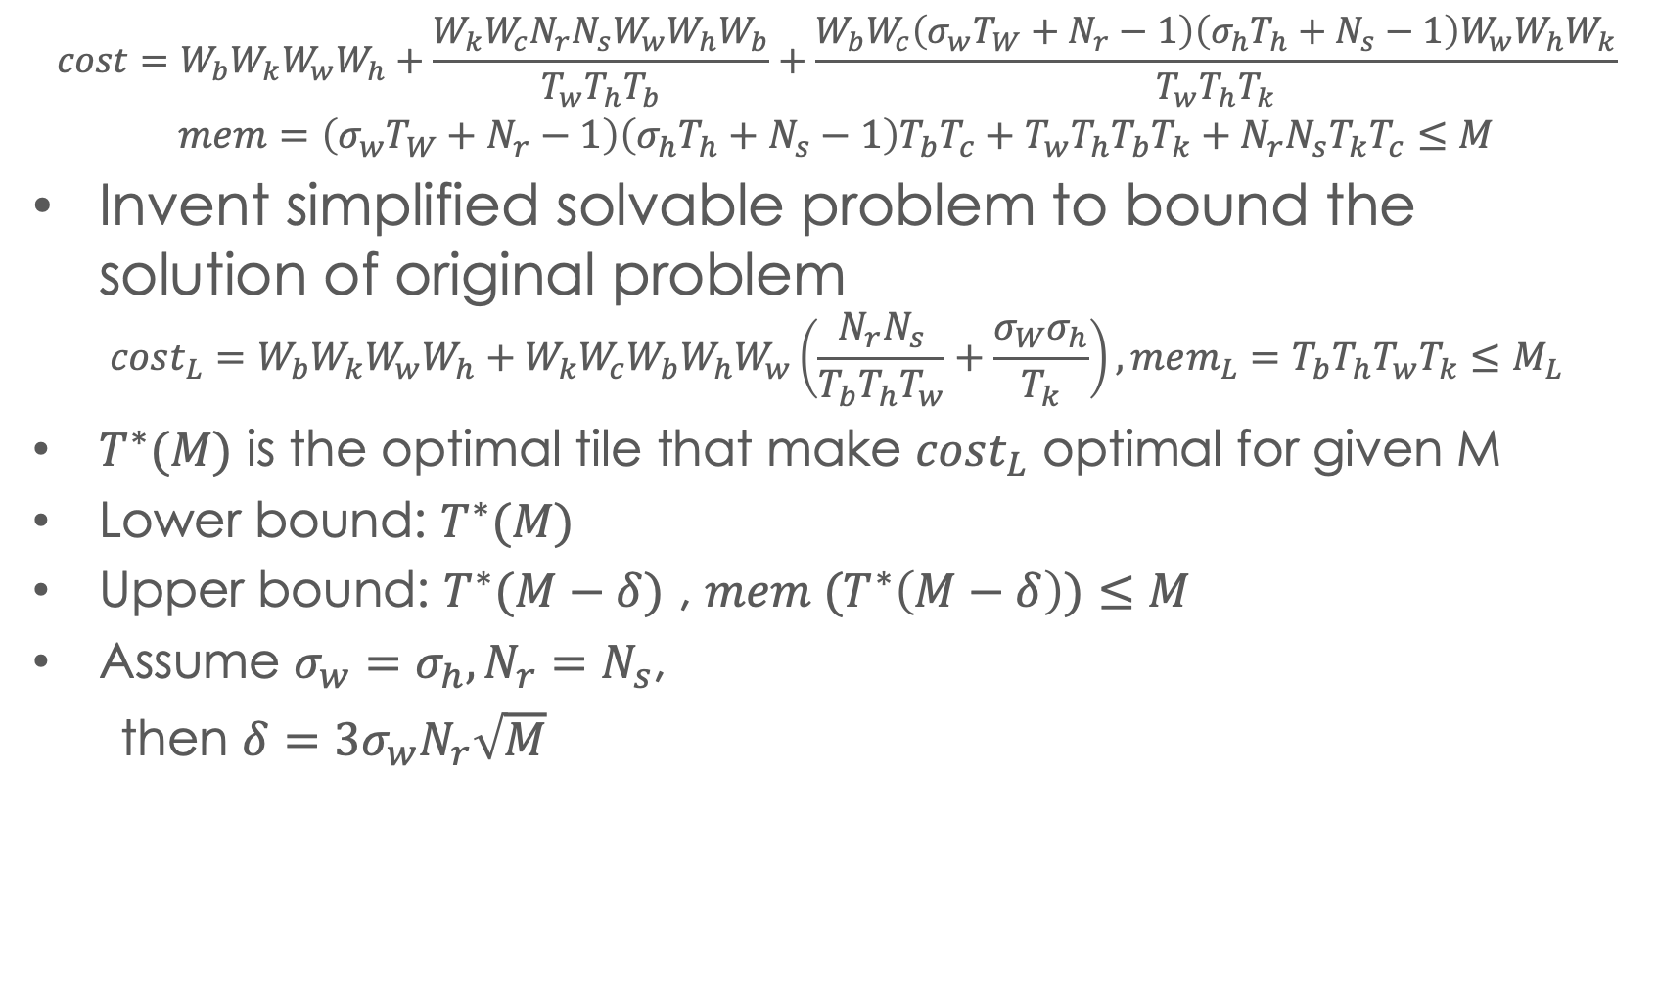
Extend to CNNS
$${cost=W}_{b}W_{k}W_{w}W_{h}+\frac{W_{k}W_{c}N_{r}N_{s}W_{w}W_{h}W_{b}}{T_{w}T_{h}T_{b}}+\frac{W_{b}W_{c}\left(σ_{w}T_{W}+N_{r}−1\right)\left(σ_{h}T_{h}+N_{s}−1\right)W_{w}W_{h}W_{k}}{T_{w}T_{h}T_{k}}$$
$$mem=\left(σ_{w}T_{W}+N_{r}−1\right)\left(σ_{h}T_{h}+N_{s}−1\right)T_{b}T_{c}+T_{w}T_{h}T_{b}T_{k}+N_{r}N_{s}T_{k}T_{c}≤M$$
Invent simplified solvable problem to bound the solution of original problem
$$cost_{L}=W_{b}W_{k}W_{w}W_{h}+W_{k}W_{c}W_{b}W_{h}W_{w}\left(\frac{N_{r}N_{s}}{T_{b}T_{h}T_{w}}+\frac{σ_{W}σ_{h}}{T_{k}}\right),mem_{L}=T_{b}T_{h}T_{w}T_{k}≤M_{L}$$
$T^{∗}(M)$ is the optimal tile that make $cost_{L}$ optimal for given M
Lower bound: $T^{∗}(M)$
Upper bound: $T^{∗}(M−δ)$ , $mem (T^{∗}\left(M−δ\right))≤M$
Assume $σ_{w}{=σ}_{h}, N_{r}=N_{s}$,
then $δ={{3σ}_{w}N}_{r}\sqrt{M}$
$T^{∗}\left(M−δ\right)$, $mem\left(T^{∗}\right)≤M$
valid solution
$T^{∗}\left(M\right)$, $mem\left(T^{∗}\right)>M$
Contour line of $mem_{L}$
Notes:
we can use the same method to build dist algo for cnn,
and we'll briefly go over the necessary key points for extension.
the opt problem of cnn is too complex to find analytical solution. instead of directly solving it we work around to create a simplifed problem which is solvable.
we will use this simp prob to create ub and lb for opt sol of original problem.
that is when we make the memory parameter the same as ori, we got a lb cost, but that is not a valid sol of ori because it violates oringal mem constraint
we reduce the memory paraeter of simp problem a little be, such that if we plug in the solution back to ori mem constraint, it fits in M. this creates a valid solution, and we know the performance loss of this solution is strict less than the ub cost - lcost
if delta small, ub close to lb

Slide 8
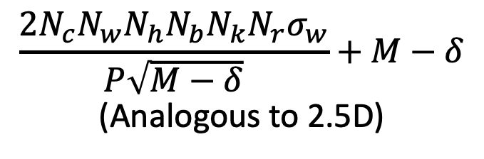
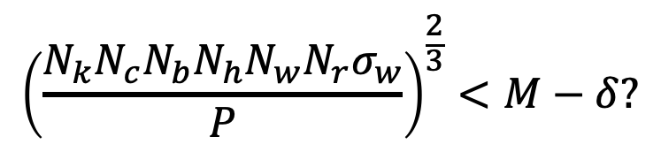
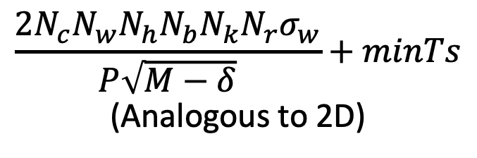
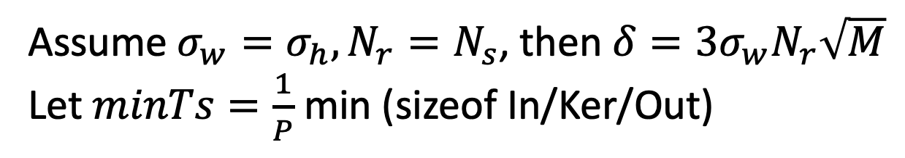
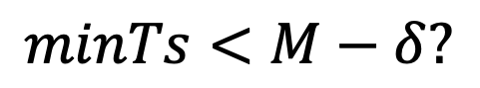
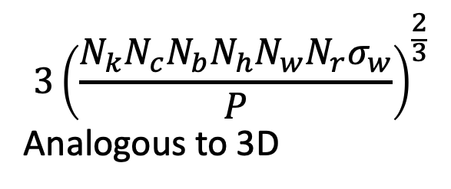
CNNs solution summary
Assume $σ_{w}{=σ}_{h}, N_{r}=N_{s}$, then $δ={{3σ}_{w}N}_{r}\sqrt{M}$
Let $minTs=\frac{1}{P}$ min (sizeof In/Ker/Out)
$$minTs<M−δ?$$
No
Yes
$$\frac{2N_{c}N_{w}N_{h}N_{b}N_{k}N_{r}σ_{w}}{P\sqrt{M−δ}}+minTs$$
(Analogous to 2D)
$${\left(\frac{N_{k}N_{c}N_{b}N_{h}N_{w}N_{r}σ_{w}}{P}\right)}^{\frac{2}{3}}<M−δ?$$
No
Yes
$$\frac{2N_{c}N_{w}N_{h}N_{b}N_{k}N_{r}σ_{w}}{P\sqrt{M−δ}}+M−δ$$
(Analogous to 2.5D)
$${3\left(\frac{N_{k}N_{c}N_{b}N_{h}N_{w}N_{r}σ_{w}}{P}\right)}^{\frac{2}{3}}$$
Analogous to 3D

Slide 9
Thanks for listening
Questions ?

